Slide 1
Object Persistence using Hibernate
Introduction to Hibernate

Slide 2

Hibernate Features Technologies and Databases supported by Hibernate Hibernate Architecture
What's in This Course
Configuration of Hibernate
Hibernate using XML
Hibernate using Annotations
Hibernate logging by Log4j
Collection Mapping in Hibernate
Hibernate mapping using XML file
Hibernate mapping using Annotations
Bidirectional Mapping
Hibernate Lazy Collection
Component Mapping
Integration of Hibernate with Spring

Slide 3
What Hibernate Does
Object - Relational mapping
Transparent persistence & retrieval of objects
Persistence of associations and collections
Guaranteed uniqueness of an object (within a session)

Slide 4
Hibernate Features
O-R mapping using ordinary JavaBeans
Can set attributes using private fields or private setter methods
Lazy instantiation of collections (configurable)
Polymorphic queries, object-oriented query language
Cascading persist & retrieve for associations, including collections and many-to-many
Transaction management with rollback
Can integrate with other container-provided services

Slide 5
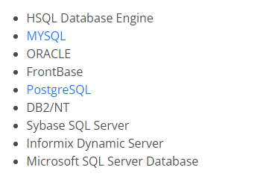
Supported Databases In Hibernate

Slide 6
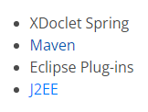
Technologies Supported By Hibernate

Slide 7
Application Architecture
User Interface
UI event
data xfer object
Application Logic
data request
domain object
Domain Objects
DAO
SessionFactory
Hibernate API
domain object
Hibernate
hibernate.cfg.xml
JDBC API
ResultSet, etc.
*.hbm.xml class mappings
Foundation Classes
JDBC

Slide 8
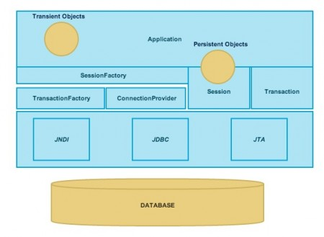
Hibernate Architecture Another Look

Slide 9
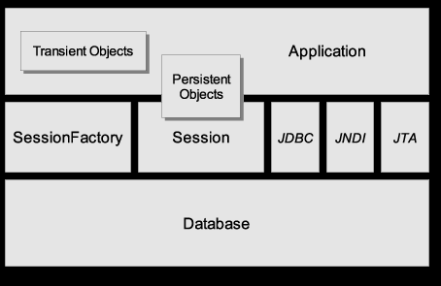
Another View
Source: Hibernate Reference Manual (online)

Slide 10
Example of Persisting an Object
// get a Hibernate SessionFactory for Session management
sessionFactory = new Configuration()
.configure().buildSessionFactory();
// an Event object that we want to save
Location ku = new Location( "Kasetsart University" );
ku.setAddress( "90 Pahonyotin Road; Bangkok" );
Event event = new Event("Java Days");
event.setLocation( ku );
Session session = sessionFactory.openSession();
Transaction tx = session.beginTransaction();
session.save( event ); tx.commit();
session.close();

Slide 11
Example of Retrieving an Object
// use the existing session factory
Session session = sessionFactory.openSession();
// query Event objects for "Java Days"
Transaction tx = session.beginTransaction();
Query query = session.createQuery(
"from Event where name='Java Days'" );
List events = query.list( );
out.println("Upcoming Java Days events: ");
for( Object obj : events ) {
Event event = (Event) obj;
String name = event.getName( );
Location loc = event.getLocation( );
...
}
tx.commit( );

Slide 12
Using Named Parameters in Query
// use the existing session factory
Session session = sessionFactory.openSession();
// Hibernate Query Language (HQL) can use named params
Query query = session.createQuery(
"from Event where name=:name");
query.setParameter( "name", "Java Days");
List events = query.list( );
out.println("Upcoming Java Days events: ");
for( Object obj : events ) {
Event event = (Event) obj;
String name = event.getName( );
Location loc = event.getLocation( );
...

